Slide 1

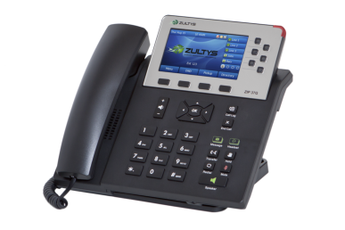
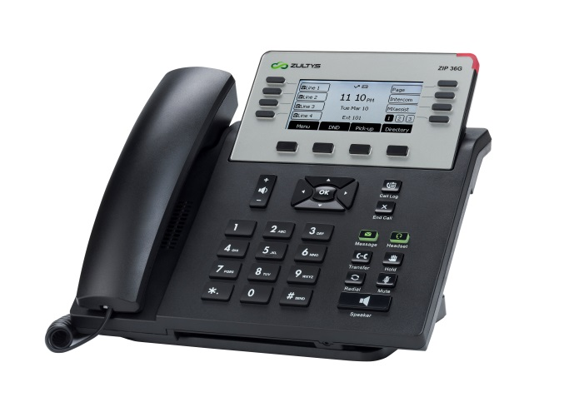
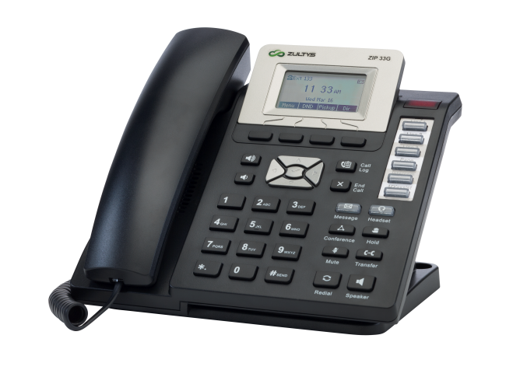
ZIP 3x Series Quick Reference Sheets
<Customizable by Channel Partner>
Proprietary & Confidential. Distribution without approval prohibited.
Copyright © Zultys, Inc. 2001 - 2016. All rights reserved.

Slide 2

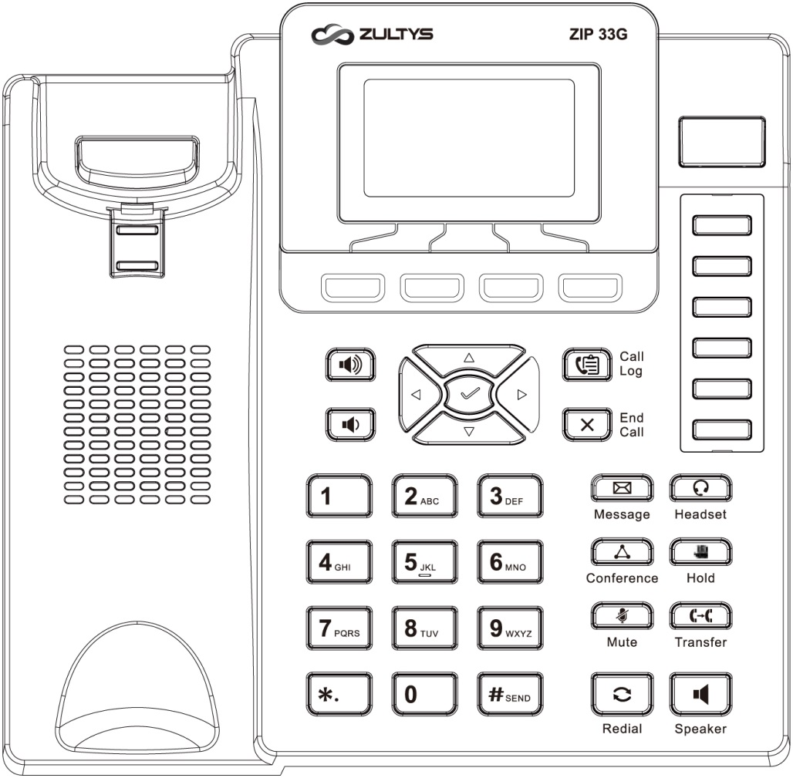
Channel Partner Logo here
Soft Key Display – contextual – options will change depending on call state
- Idle State: Menu | Do Not Disturb | Pick Up | Directory
- Dialing: Send | 123 (entry mode) | Delete (last digit) | Cancel
- Connected Call: Transfer | Hold | Park | Cancel
Name:
ZIP 33G
Extension
DID
MXIE Login Credentials
12:00 PM
Message Waiting /
Mute Indicator
Login Name (case sensitive)
Password
MX URL
Assigned Phone ID
Menu DND Pickup Dir
Call Appearance 1
Call Appearance 2
Call Appearance 3
Custom 1
Custom 2
Support Contact
Custom 3
Call Log – Access history of dialed/received calls – use navigation keys
End Call – Terminate call in progress. Cancel operation when idle
Message – Access voice mail
Headset – Activate headset mode & answer to headset (requires headset)
Conference – Phone-based 3 Party conference – Press [Conference] while on call, enter number then press [Send], wait until call is answered then press [Conference].
Hold – Place call on hold / Retrieve call from hold
Mute – Mute microphone during active call. Mute Indicator will flash Red
Transfer – Blind: [Transfer] [Ext Number] [Transfer]
Transfer – Supervised: [Transfer] [Ext Number] [Send], announce call, [Transfer]. To cancel transfer, press [X] then press flashing line key to retrieve original call
Redial – Access recently dialed numbers. Press twice to redial last number
Speaker – Activate hands-free mode / Group listen when on handset
Volume Up / Down used for
- Ring volume when idle
- Handset volume when on call
- Speaker volume when on call
- Headset volume when on call
Send –Initiate a call once number is entered
Menu Navigation
- Left / Right
- Up / Down
- Select

Slide 3
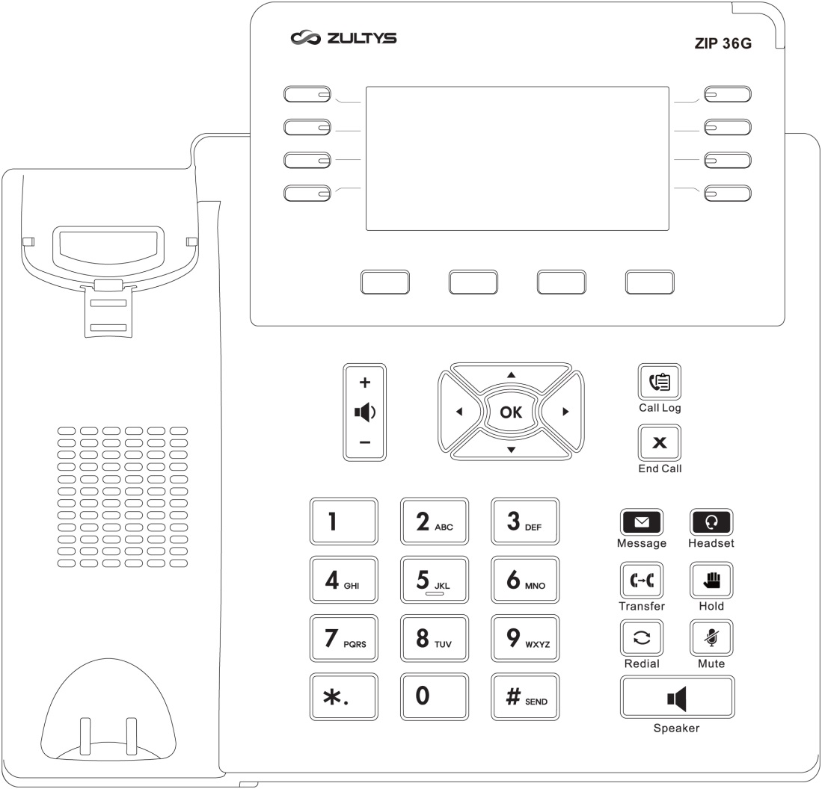
Soft Key Display – contextual – options will change depending on call state
- Idle State: Menu | Do Not Disturb | Pick Up | Directory
- Dialing: Send | 123 (entry mode) | Delete (last digit) | Cancel
- Connected Call: Transfer | Hold | Park | Cancel
Name:
ZIP 36G
Extension
DID
Call Appearance 1
Call Appearance 2
Call Appearance 3
MXIE Login Credentials
Message Waiting Indicator (MWI)
Login Name (case sensitive)
Password
MX URL
Assigned Phone ID
12:00 PM
Custom 2
Custom 1
Custom 3
Custom 4
Menu
DND
Pickup
Dir
Custom 5
Support Contact
Call Log – Access history of dialed/received calls – use navigation keys
End Call – Terminate call in progress. Cancel operation when idle
Message – Access voicemail
Headset – Activate headset (if headset is connected)
Conference – Phone-based 3 Party conference – Press [Conference] while on call, enter number then press [Send], wait until call is answered then press [Conference]
Hold – Place call on hold / Retrieve call from hold
Mute – Mute speaker or handset microphone during active call
Transfer – Blind: [Transfer] [Ext Number] [Transfer]
Transfer – Supervised: [Transfer] [Ext Number] [Send], announce call, [Transfer]. To cancel transfer, press [X] then press flashing line key to retrieve original call
Redial – Access recently dialed numbers. Press twice to redial last number
Speaker – Activate hands-free mode / Group listen when on handset
Volume Up / Down used for
- Ring volume when idle
- Handset volume when on call
- Speakerphone volume when on call
Send –Initiate a call once number is entered
Menu Navigation
- Left / Right
- Up / Down
- OK (Select)

Slide 4
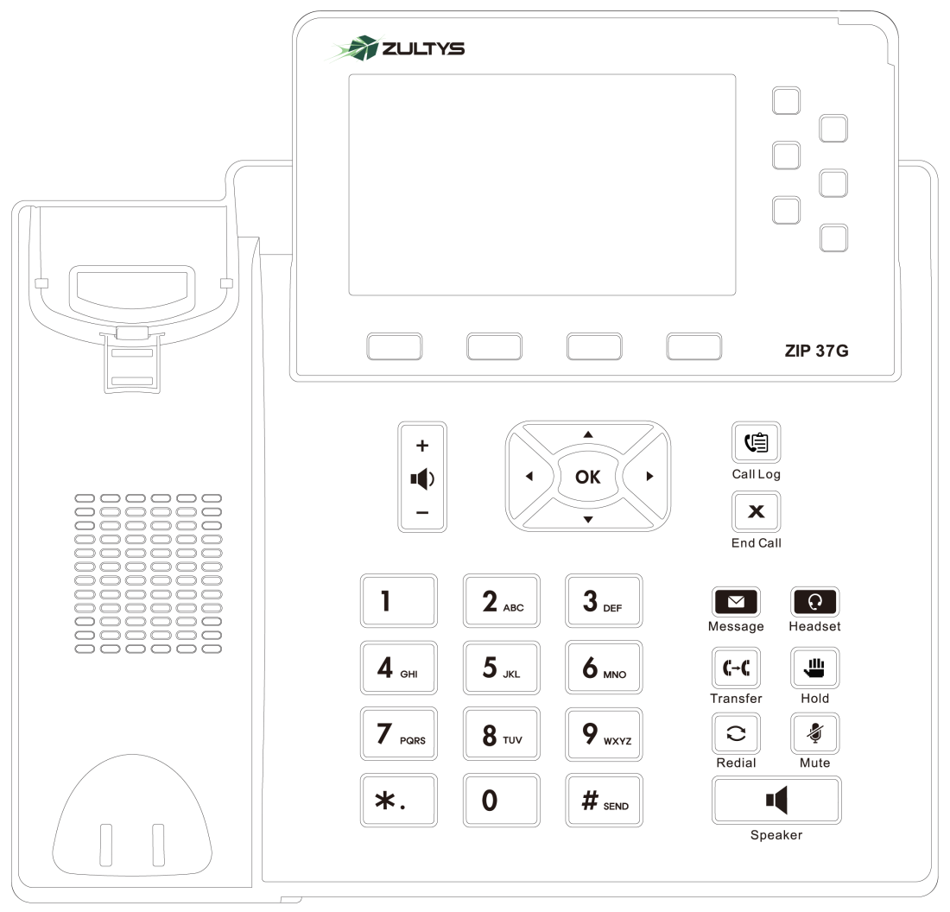

Soft Key Display – contextual – options will change depending on call state
- Idle State: Menu | Do Not Disturb | Pick Up | Directory
- Dialing: Send | 123 (entry mode) | Delete (last digit) | Cancel
- Connected Call: Transfer | Hold | Park | Cancel
Name:
ZIP 37G
Extension
DID
MXIE Login Credentials
Message Waiting Indicator (MWI)
Login Name (case sensitive)
Password
MX URL
Assigned Phone ID
12:00 PM
Call Appearance 1
Call Appearance 2
Call Appearance 3
Menu
DND
Pickup
Directory
Custom 1
Custom 2
Custom 3
Support Contact
Call Log – Access history of dialed/received calls – use navigation keys
End Call – Terminate call in progress. Cancel operation when idle
Message – Access voicemail
Headset – Activate headset (if headset is connected)
Conference – Phone-based 3 Party conference – Press [Conference] while on call, enter number then press [Send], wait until call is answered then press [Conference]
Hold – Place call on hold / Retrieve call from hold
Mute – Mute speaker or handset microphone during active call
Transfer – Blind: [Transfer] [Ext Number] [Transfer]
Transfer – Supervised: [Transfer] [Ext Number] [Send], announce call, [Transfer]. To cancel transfer, press [X] then press flashing line key to retrieve original call
Redial – Access recently dialed numbers. Press twice to redial last number
Speaker – Activate hands-free mode / Group listen when on handset
Volume Up / Down used for
- Ring volume when idle
- Handset volume when on call
- Speakerphone volume when on call
Send –Initiate a call once number is entered
Menu Navigation
- Left / Right
- Up / Down
- OK (Select)

